Slide 1
FLIGHT PRICE PREDICTION
SUBMITTED BY
KRISHNA PRASAD

Slide 2

FLIGHT

Slide 3
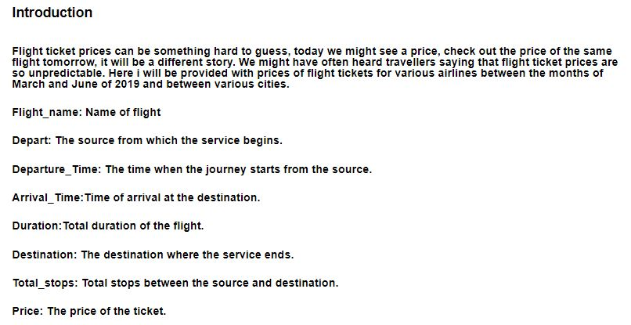
Introduction

Slide 4
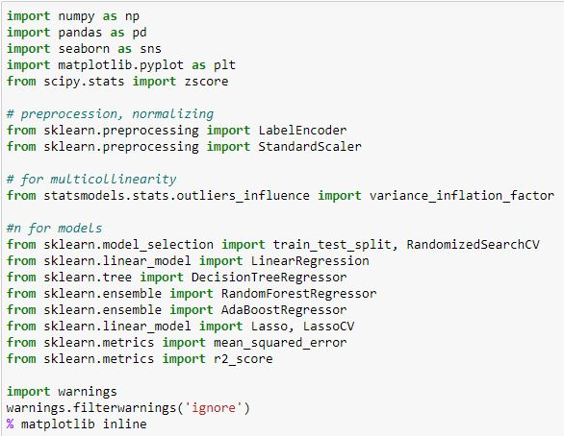
LIBRARIES

Slide 5
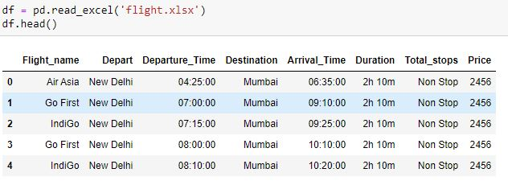
Dataset

Slide 6

CHECKING ROWS & COLUMNS

Slide 7
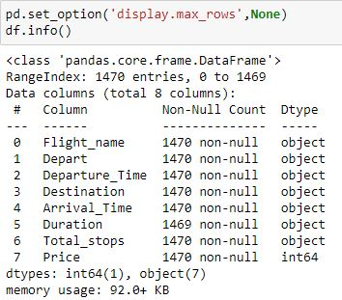
Checking columns type

Slide 8

CHECKING DUPLICATES

Slide 9
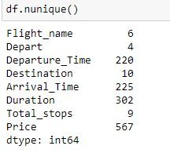
CHECKING CONTINOUS & CATEGORICAL COLUMNS

Slide 10
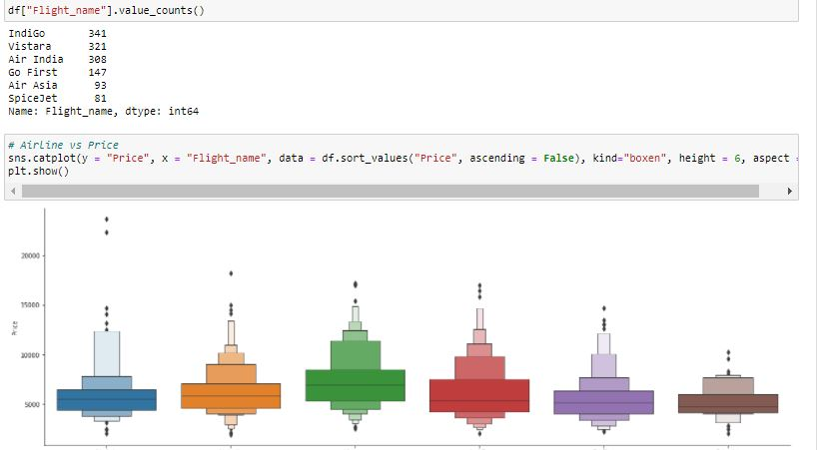
Flight Name

Slide 11
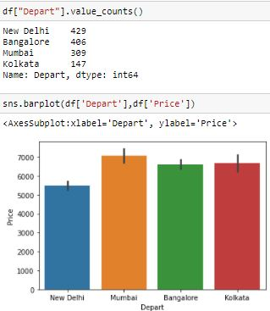
Departure

Slide 12
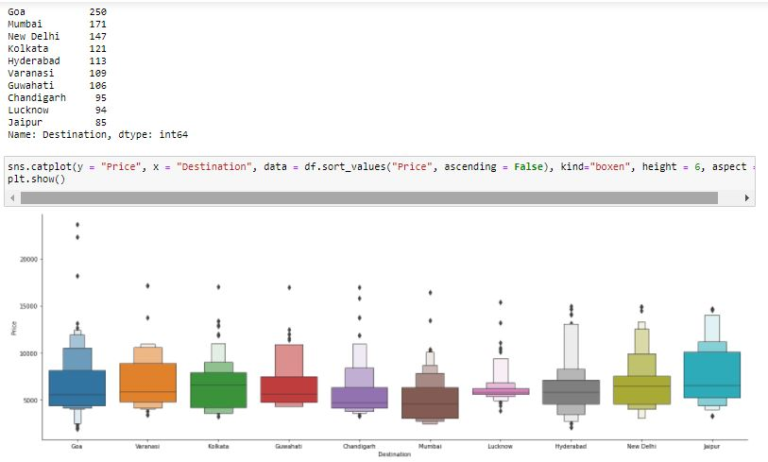
Destination

Slide 13
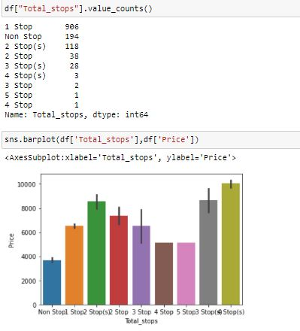
Total stops

Slide 14
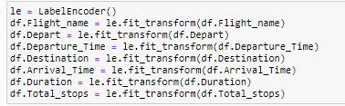
Label Encoder

Slide 15
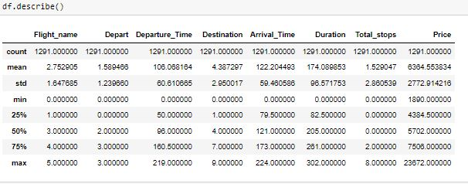
Describe columns

Slide 16
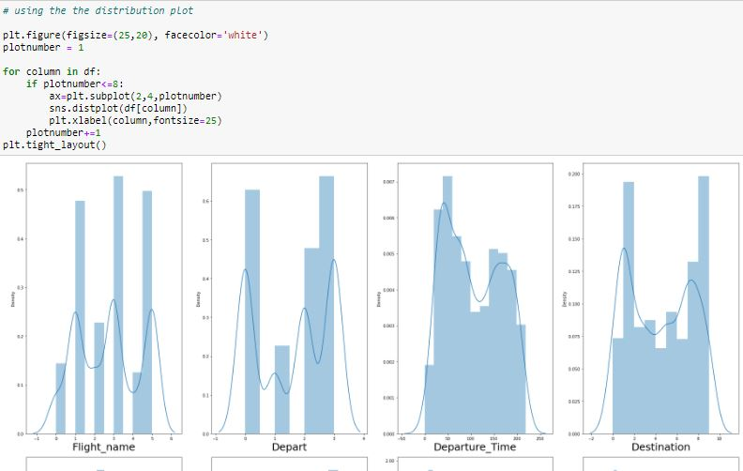
Distribution Plot

Slide 17

Replacing continuous columns

Slide 18
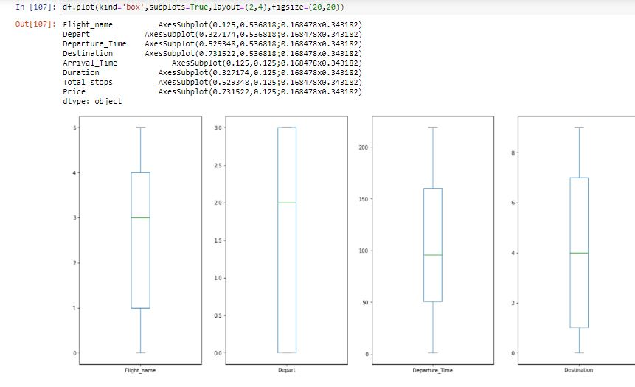
Box Plot

Slide 19
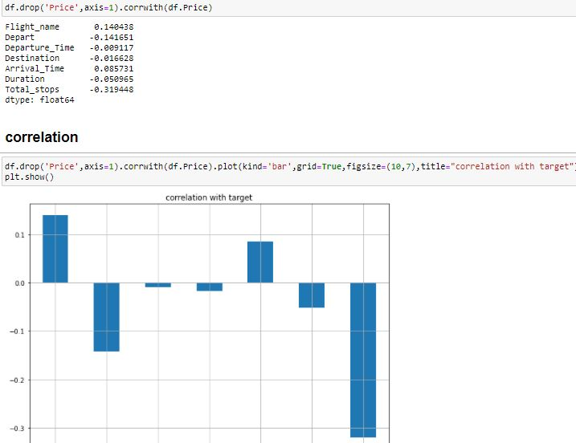
Correlation

Slide 20

Dividing the dataset

Slide 21
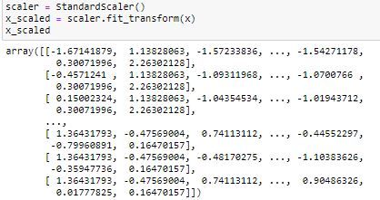
Standard Scaler

Slide 22
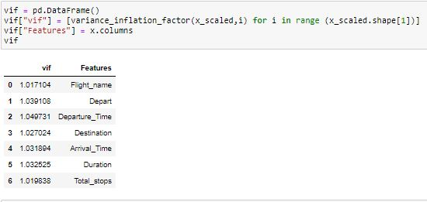
VIF Variance Inflation Factor

Slide 23
Train Test Split

Slide 24
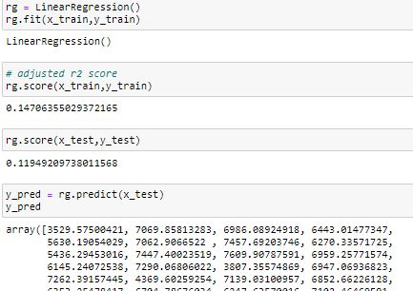
Linear Regression

Slide 25
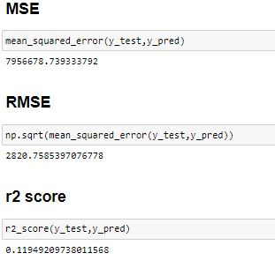
Accuracy Score

Slide 26
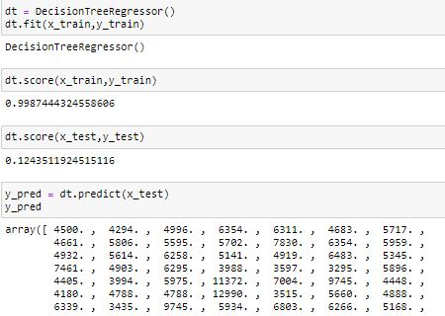
Decision Tree Regressor

Slide 27
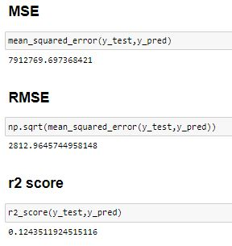
Accuracy Score

Slide 28
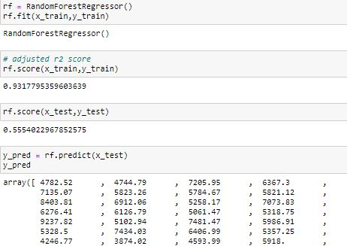
Random Forest Regressor

Slide 29
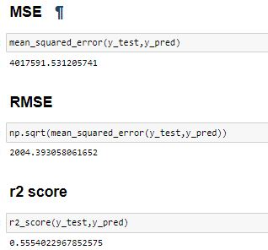
Accuracy

Slide 30
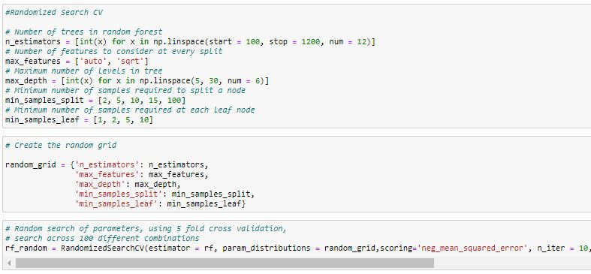
Randomized Search CV

Slide 31
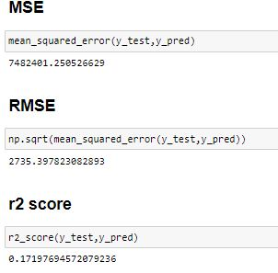
Accuracy Score

Slide 32
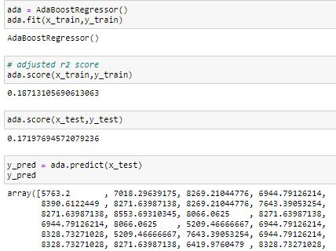
Ada Boost Regressor

Slide 33
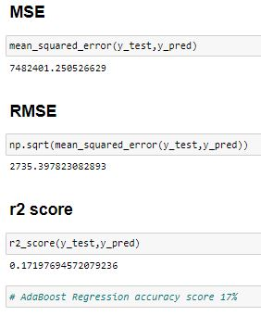
Accuracy Score

Slide 34
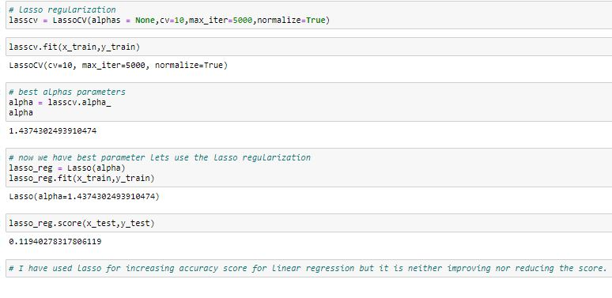
Lasso

Slide 35
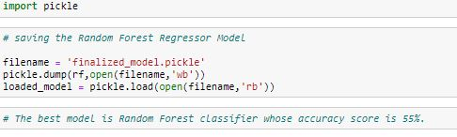
Saving Best Model

Slide 36
Interpretation of the Results
I have used visualization tool such as cat Plot and Bar Plot to understand the data in a better way.
I used describe method for five-point summary analysis and also found the number of rows and columns in dataset.
I have done the model building with 4 algorithms and the best model is Random Forest Regressor with an accuracy score of 55%

Slide 37
CONCLUSION
I have managed out how to prepare a model that gives users for a novel best approach at future lodging value predictions.
I have train dataset from which I had to extract information.
I had used pandas library to read the Dataset which provide me to explore & visualize the Data properly based on Rows & Columns.
I did exploratory data analysis on main data frame and tried to see all visualizations.
Based on visualization knowledge, I use various EDA TECHNIQUES to plot the count plot.
After from all these I split the Features & Labels into 2 parts.
On this data, I have applied our machine learning regressor models such as Linear regression, Decision Tree Regressor, Random forest classifier and Ada Boost train dataset.
After which I found Random forest Regressor has the High accuracy score 55% and best among all the regressor models.

